Slide 1
Tutoring Center
By: Gutterboyz & Son

Slide 2
Welcome to Tutoring Center, your new Tutoring Center Application!

Slide 3
Table of Contents
Section 1: Installation
Setup
Section 2: How to use the Tutoring Center Application ( Basics )
How to Sign Up
How to Login
How to Check and Schedule Appointments
How to Read and Write Reviews
How to Change Password, Username, and all Profile-Based Information
Logout
How to Check Grades and Attendance
Section 3: How to use the Tutoring Center Application ( Student )
How to Schedule an Appointment
How to Take Quizzes
Section 4: How to use the Tutoring Center Application ( Tutor )
How to Create Assignments
How to Create a Quiz

Slide 4
Section 1: Installation

Slide 5
Installation
(Option 1, with IntelliJ)
You can download the zip for our program on GitHub here, https://github.com/GutterboyzSon/TutoringCenter.
After extraction you can open the IntelliJ IDE, and use the “Open” option on the main screen. Navigate to the extraction folder with all the program folders in it, and open it.
Go to File>Project Structure>Modules>Dependencies, If there are any dependencies that are highlighted in red, you can remove them.
Add the dependencies by pressing the + button and add the JARs (controlsfx-8.40.14.jar, jfoenix-8.0.7.jar, json-simple-1.1.1.jar) from the Libraries folder. Then click “Apply”.
Go to the the Main class and right click the main file and then run the application.

Slide 6
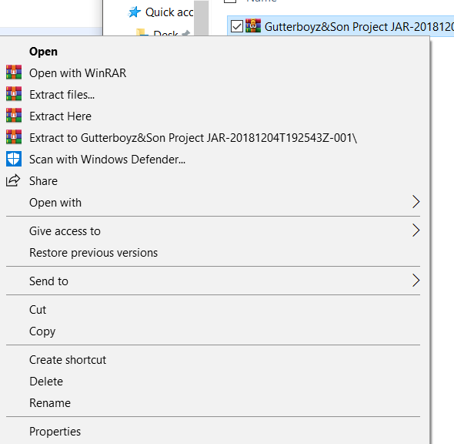
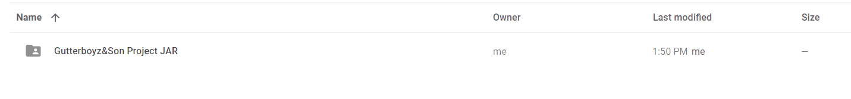
Installation
From https://drive.google.com/drive/folders/1dt5OVVwKusBha9vwhMqD4AfxMN4h6bHz you will have the ability to right click our project file, and download the ZIP folder.
In your download folder, you will have the ZIP folder. Right click and choose the Extract option.
From your download folder, or where you moved the Application in your computer, there will be a runnable JAR File.
This is all you will need for beginning an adventure into learning!

Slide 7
Section 2: How to use the Tutoring Center Application ( Basics )

Slide 8
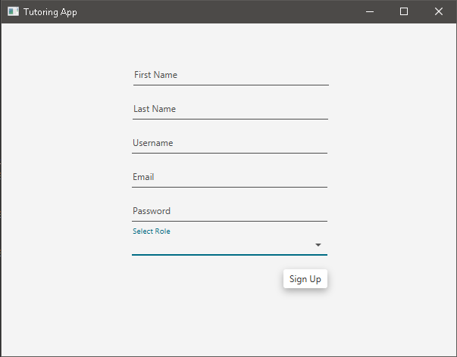
Sign Up
How to SIGN-UP
To sign up for the Tutoring Center you must enter in the following fields.
First Name
Last Name
UserName (must be between 6 to 32 Characters)
Email
Password (must be between 6 to 32 Characters)
Role (Choose from Student or Tutor)
You must pick one of two roles Student or Tutor. This can be changed later in the application.

Slide 9
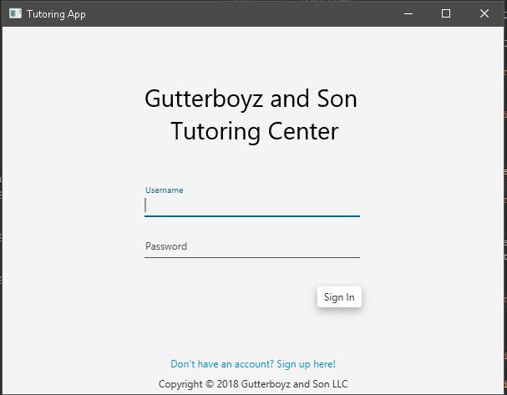
Login
How to LOGIN
To LOGIN into an account you must provide the associated username a password into the associated fields.
You can make your own account by creating account with the hyperlink below.

Slide 10
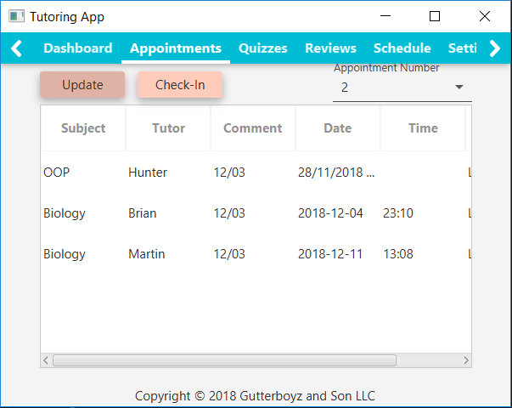
How to Check Appointments
Under the Appointments Tab Students can check the scheduled appointments, and updated list is created when the UPDATE button is pressed.
Users can select the appointment number (given by its position on the chart) and click CHECK-IN, to check-in to their appointment. This will provide the current date and can be modified by tutors.

Slide 11
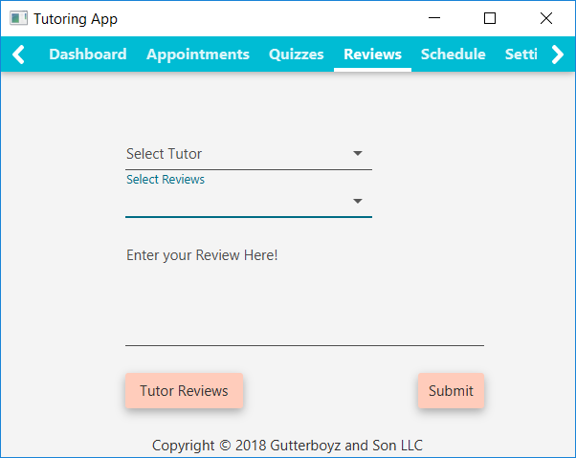
Submitting Reviews
As a user you can SUBMIT a REVIEW of a specific tutor by: Selecting the Tutor, Selecting the Subject, Writing the review in the given area, And Submitting.
Tutor Reviews can be searched for by clicking the “Tutor Reviews” button.

Slide 12
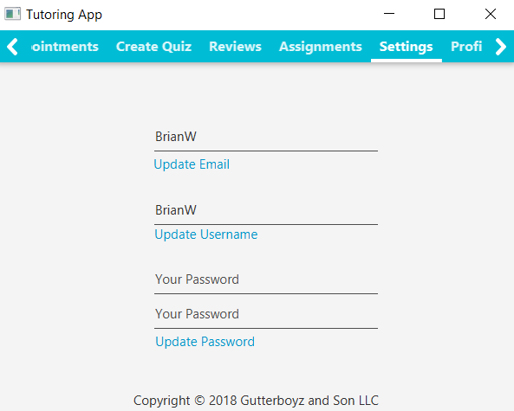
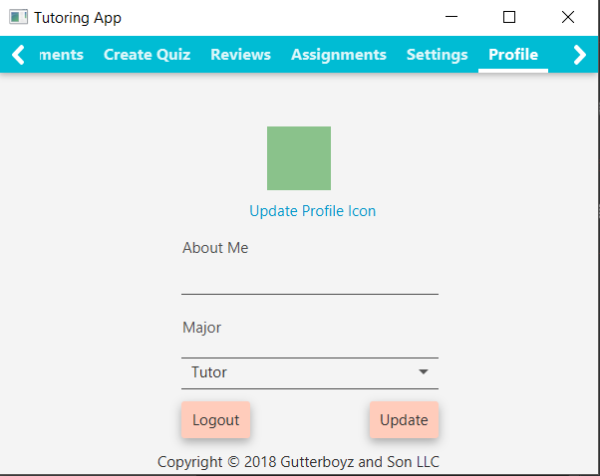
How to Change Password, Username, Email and other Profile Based Information.
From this section, you will be able to insert fields for your About, Major, and swap from Tutor to Student, Student to Tutor.
These changes will be saved upon button press of UPDATE.
You also have the option to LOGOUT from this screen.
From our Settings screen you can update your email, username, and password by inputting them and pressing the UPDATE button below the field.

Slide 13
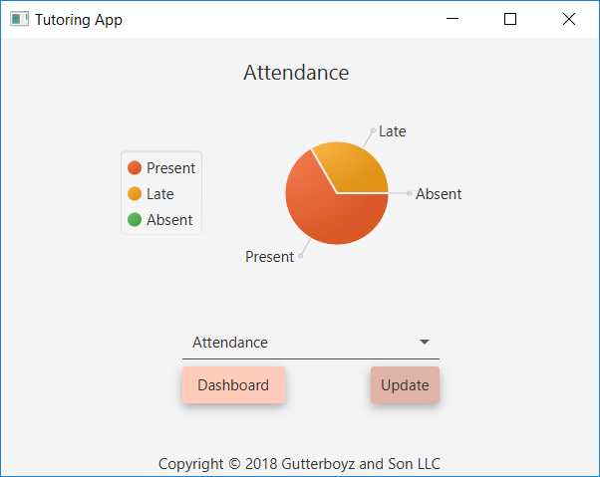
Grades and Attendance
By clicking the “Grades and Attendance” button on the Dashboard, it will bring you to this window.
You can select between attendance or grades. A pie chart be displayed with the correct proportions for the student after pressing UPDATE
Tutors have the option to select a Student and check over their Attendance and Grades as well.
To go back, click “Dashboard”.

Slide 14
Section 3: How to use the Tutoring Center Application ( Student )

Slide 15
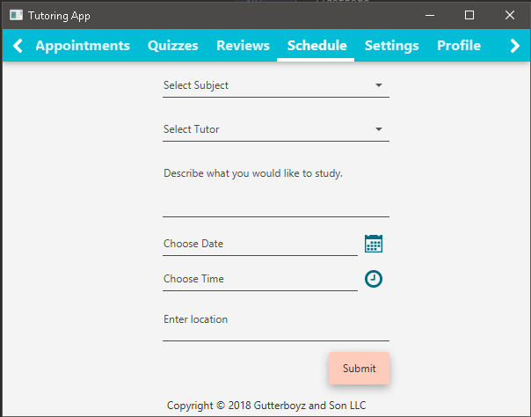
Student:
How to Schedule an Appointment
When logged in as a student the user can ADD AN APPOINTMENT for the account by selecting the subject, tutor, comment, location, date, and time.
This information will be stored and added to your appointments table.

Slide 16
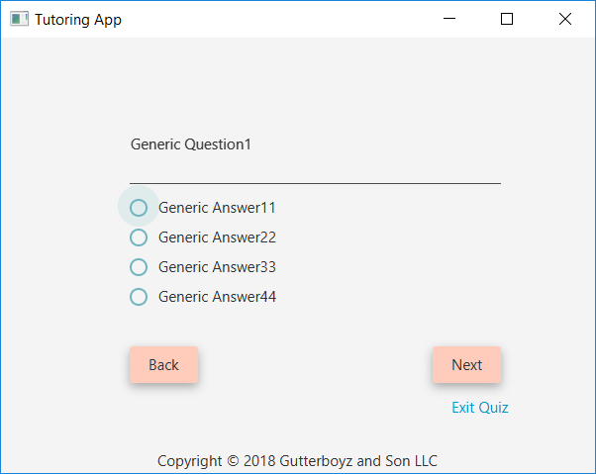
Student
Taking a Quiz
Under the Quiz Tab, students can select from multiple quizzes to take.
While taking the quiz there will be multiple choice questions. Students can navigate between questions and submit when they get to the end of the quiz.
At any time the student can exit the quiz by clicking “Exit Quiz”.

Slide 17
Section 4: How to use the Tutoring Center Application ( Tutor )

Slide 18
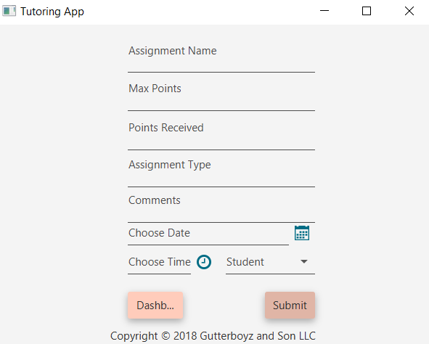
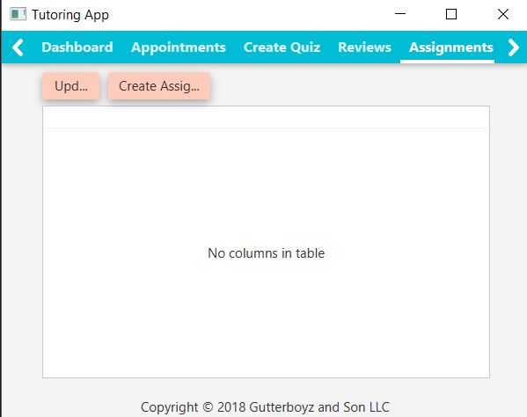
Tutor
How to Create Assignments
From the “Assignments” section of the Dashboard the user will find the Assignments table.
All active assignments are listed here.
Using the CREATE ASSIGNMENT button will allow a tutor to add an assignment with all fields to the table
Using the UPDATE button will add any new assignments to your table.

Slide 19
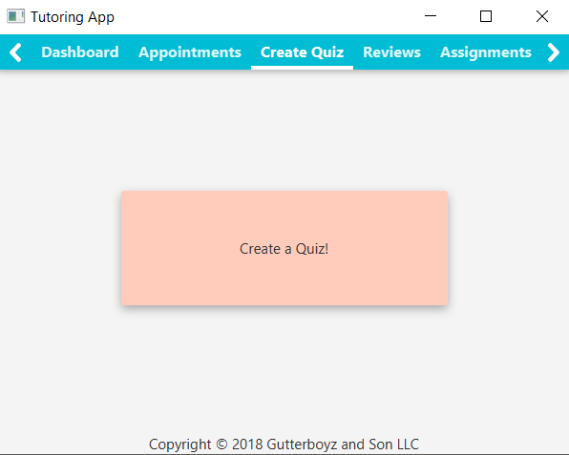
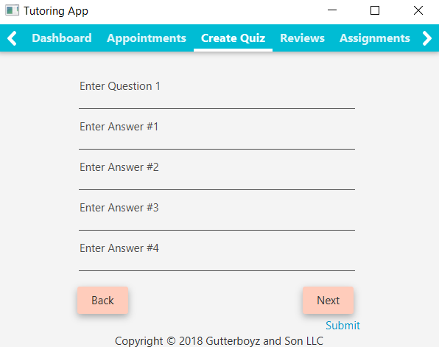
Tutor
How to Create a Quiz
From the “Create Quiz” section of the Dashboard, there is button for a tutor to Create a new Quiz.
Upon pressing, the user is prompted to fill in 5 multiple choice questions with 4 answers. This is currently the only quiz format.
Pressing NEXT will move to the next question for answering, BACK will go to the previous. SUBMIT will finish your quiz.
Correct answers must have an * in the answer. They are removed from student’s answers, but are the only way to identify correct answers. Only one answer may be correct.

Slide 20
Thank you for reading!

